Slide 1
TNGS Learning Solutions INTRODUCTION TO CLOUD COMPUTING

Slide 2
INTRODUCTION TO CLOUD COMPUTING
What is Information Technology?
What is Cloud computing?
Why Cloud Computing?
What are benefits of Cloud Computing?
What are the disadvantages of Cloud Computing?

Slide 3
Definition of Cloud Computing
Information technology (IT) is the use of any computers, storage, networking and other devices, infrastructure and processes to create, process, store, secure and exchange all forms of electronic data.
Cloud computing is the on-demand delivery of IT resources and applications through internet with pay-as-you-go pricing model.
Whether you run applications or deliver services that support the critical operations of your business, the cloud provides rapid access to flexible and low-cost IT resources.
With cloud computing, you don’t need to make large up-front investments on hardware/software and spend a lot of time managing that resources.

Slide 4
Definition of Cloud Computing
The practice of using a network of remote servers hosted on the internet to store, manage, and process data, rather than a local server or a personal computer.

Slide 5

On-Premises Data Center

Slide 6
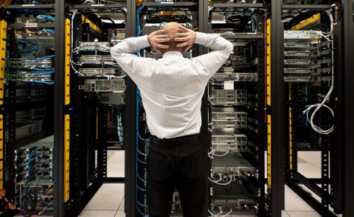
We don’t want to manage physical servers – Let’s move to the cloud!

Slide 7
Cloud Computing Cont……
Cloud computing provides an easy way to access servers, storage, databases, and a broad set of application services over the internet.
Cloud computing providers such as AWS owns and maintain the network-connected hardware required for those application services, while you provision and use what you need for your workloads.

Slide 8
WHY CLOUD COMPUTING ?
Many businesses large and small use cloud computing today either directly (e.g. Google or Amazon) or indirectly (e.g. Twitter) instead of traditional on-site alternatives.
Reduction of costs
Universal access
Up to date software
Choice of applications
Potential to be greener and more economical
Flexibility

Slide 9
BENEFITS OF CLOUD COMPUTING
Faster Deployments:
Because there’s no wait for local computing resources
Usage-based pricing:
Letting you pay only for what you use
Less financial risk:
With lower up-front investment in hardware and software
Easier upgrades:
With no on-premises software to update
Reduced need for on-premises resources:
such as servers and IT staff

Slide 10
DISADVANTAGES OF CLOUD COMPUTING
Security Issues:
Security is the major issue in cloud computing.
The cloud services implement the best security standards and industry certifications.
However, storing data on an external service providers always bears a risk.
Technical Issues:
You always need to rely on the internet to uploading/downloading and migrating.

